Slide 1
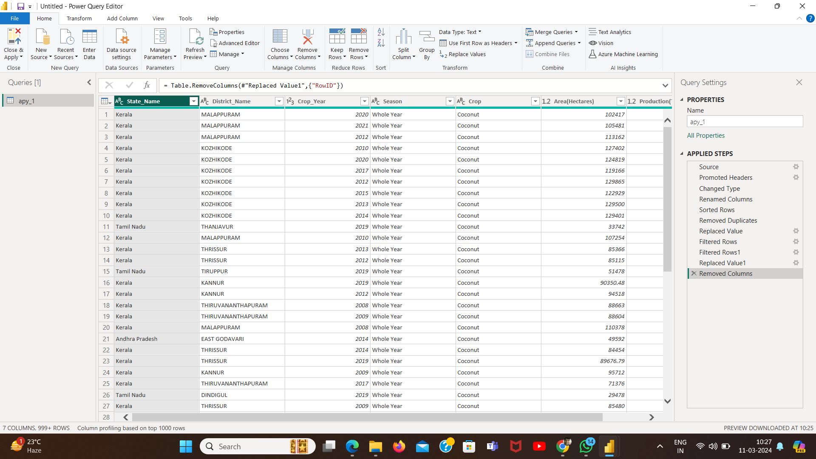
Name – Md Mahfooz Alam Ansari
Student id - STU64bec89eb7f7e1690224798
Project - P2 - Power BI-Driven Exhaustive Analysis of Indian Agriculture Sector

